Slide 1
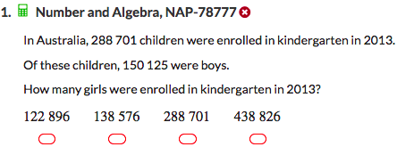
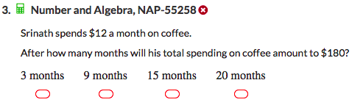
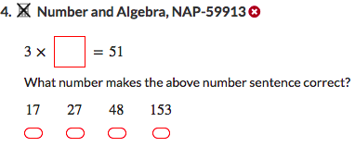
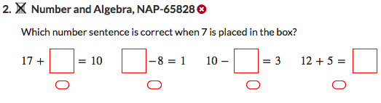
Today’s lesson is about the associative, commutative and distributive laws in maths and how we can use these to make maths easier.
You will need your pens and your INB. You will not need your device.
Topic: Laws of operations
EQ : How can the associative, commutative and distributive law make maths easier?
While you are waiting to start, try these..

Slide 2
Commutative Laws
On your Left Hand Side write out these sums and solve each of them (no calculators).
Now let’s try these ones.
What do you notice about the answers?
7 + 2 =
15 + 36 =
171 + 487 =
432 + 614=
9
2 + 7 =
36 + 15 =
487 + 171 =
614 + 432=
9
51
51
658
658
1,046
1,046
So what can we say about the order of the numbers when we do addition?

Slide 3
Now let’s try subtraction.
On your Left Hand Side find the solution to each of these (no calculators).
Would I get the same answer for these questions?
7 - 2 =
36 -15 =
432 - 212 =
5
2 - 7 =
15 – 36 =
212 - 432 =
21
220
So how can we say that subtraction and addition different?

Slide 4
Multiplication and division.
On your Left Hand Side evaluate each of these (no calculators).
Would I get the same answer for these questions?
14
7 x 2 =
6 x 15 =
24 x 5 =
24 ÷ 6 =
48 ÷ 4 =
2x 7 =
15 x 6 =
5 x 24 =
6 ÷ 24=
4 ÷ 48 =
90
120
4
12
So what can we say about multiplication and division?

Slide 5
24
7
30
Topic: Laws of operations
Date
EQ : How can the associative, commutative and distributive law make maths easier?
The "Commutative Laws" say we can swap numbers around and still get the same if the sum only contains addition or multiplication.
Eg 4 + 12 = 12 + 4 or 6 x 3 = 3 x 6
There are more notes to come – please leave room
Practise - On your LHS page
Use the commutative law to rewrite these (swap the numbers around) only if they can be swapped around.
Eg a) 2 x 5 = 5 x 2 b) 15 ÷ 3 = can’t do
9 x 12 = ________ d) 23 – 5 = ________ e) 45 + 23 = __________
f) 24 ÷ 8 = ________ g) 12 + 7 = ________ h) 457 x 213 = _________

Slide 6
Associative Law
On your Left Hand Side calculate each of the following (using you head – no calculators).
Does this work with division or subtraction?
70
2 x 7 x 5 =
2 x 5 x 7=
6 + 9 + 7 + 1 + 3=
7 + 3 + 9 + 1 + 6 =
What do you notice about the answers?
24 ÷ 2 ÷ 3 =
2 ÷ 3 ÷ 24 =
15 – 7 – 6 =
6 – 7 – 15 =
70
26
26
Did you find calculating a or b easier? How about c or d?

Slide 7
24
7
30
Topic: Laws of operations
Date
EQ : How can the associative, commutative and distributive law make maths easier?
Add this to your RHS notes
The "Associative Laws" say that it doesn't matter which we calculate first (when doing sums with only all addition or all multiplication). So we can do the easy ones first.
eg 5 + 9 + 7 + 5 + 1
5 + 5 + 9 + 1 + 7 =
10 + 10 + 7 = 17
25 x 13 x 4
25 x 4 x 13 =
100 x 13 = 1300
On your LHS do the following practise.
Use the associative law to make these calculations easier, then solve them.
Eg a) 2 x 9 x 5 = 5 x 2 x 9 b) 14 + 21 + 6 = 14 + 6 + 21
= __90__ = ___41__
5 x 13 x 2= ________ d) 6 + 5 + 34 = _________ e) 9 + 13 + 21 + 8 + 7= _________
      = ________ = ________ = ________
f) 4 x 3 x 5 = ________ g) 86 + 91 + 14 = ________ h) 50 x 7 x 2= _________
= ________ = ________ = ________

Slide 8
On your Left Hand Side calculate each of the following (using you head – no calculators).
5 x 6 =
5 x 4 + 5 x 2 =
14 x 7 =
10 x 7 + 4 x 7 =
30
What do you notice about the questions?
30
98
98
Did you find calculating a or b easier? How about c or d?

Slide 9
24
7
30
Topic: Laws of operations
Date
EQ : How can the associative, commutative and distributive law make maths easier?
Add this to your RHS notes
The “Distributive Law" allows us to break up a hard multiplication into easier pieces and then add the answers together to get the solution.
eg 14 x 6 = 10 x 6 + 4 x 6
= 60 + 24
= 84
214 x 3 = 200 x 3 + 10 x 3 + 4 x 3
= 600 + 30 + 12
= 642
Use the distributive law to make these calculations easier, the solve them.
Eg a) 3 x 13 = 3 x 10 + 3 x 3 b) 5 x 126 = 5 x 100 + 5 x 20 + 5 x 6
= _30 + 9 = 39 = 500 + 100 + 30 = 630
5 x 13 x 2= ________ d) 6 + 5 + 34 = _________ e) 9 + 13 + 21 + 8 + 7= _________
f) 4 x 3 x 5 = ________ g) 86 + 91 + 14 = ________ h) 50 x 7 x 2= _________
i) 17 x 12 = _________ j) 327 x 3 = ________ k) 2154 x 2 = _________

Slide 10

Think Pair Share.
Think – what was today’s lesson about? How can I summarise it?
Pair - Share you idea for a summary with your neighbour.
Share – Do you have a good summary? Share it with the class when asked.
Add to your glossary
Commutative Laws - says we can swap numbers around if adding or multiplying.
Associative Laws - says we can do the easy ones first when adding or multiplying.
Distributive Law – lets us break up multiplication into easier pieces then add the answers together.

